Slide 1

T.E.(E&TC) 2022-23
MINI PROJECT
ON
Submitted by
WEATHER STATION MONITORING SYSTEM USING ESP32
Sr. No. | Name | Roll No.
1. | Akshada Gade | ETTB06
2. | Swapnali Tayade | ETTB15
Guided by
Prof . S. S. Salve

Slide 2
CONTENT
Abstract
Introduction
Hardware Requirement
Process Flow Diagram
Circuit Diagram
Advantages
Result
Conclusion
References

Slide 3
Abstract
The system is designed to measure the weather conditions like temperature, pressure, humidity .
This system continuously provides real time data (weather conditions) over limited or controlled areas, for example, agriculture fields, homes or a particular room, industries etc.
Although we have satellites for weather monitoring but to perform research over a particular area, the data observed should be highly accurate which is not possible with satellites
ESP32 will be acting as an interface medium between the various sensors and the web-server. ESP32 module is also responsible for collecting, processing and then communicating the data to the server.
The real-time data stored on the web server can be further used for research and analysis of weather conditions of a particular place

Slide 4
Introduction
The ESP32 is a versatile microcontroller with built-in Wi-Fi and Bluetooth capabilities, making it an ideal platform for collecting, processing, and transmitting data.
Weather Quality Monitoring Networks allow the measurement, operation and predictive analysis of the evolution of air pollution in different areas.
ESP32 development board Plays important role In the project
The prototype connect with Wi Fi and uploads all air parameters To centralized Server
A weather station monitoring system using the ESP32 is a system designed to measure and monitor air quality.

Slide 5
Hardware Requirement
ESP32 Development Board
DHT11 Temperature & Humidity Sensor
BMP180
Micro USB Cable
Software Used
Arduino IDE
Blynk Application

Slide 6
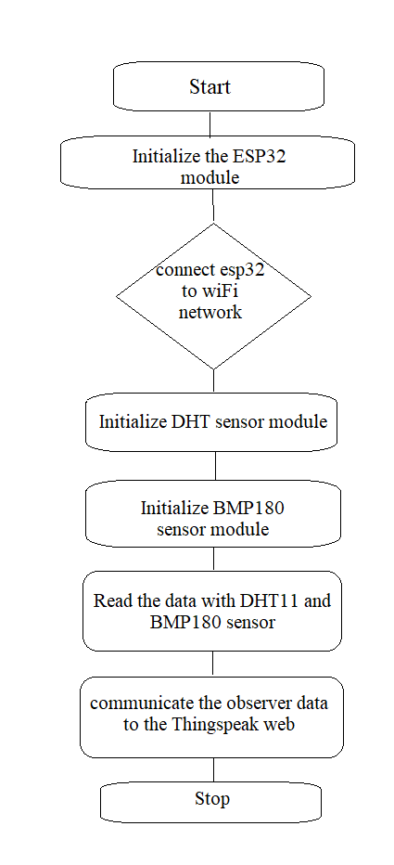
Process flow diagram

Slide 7
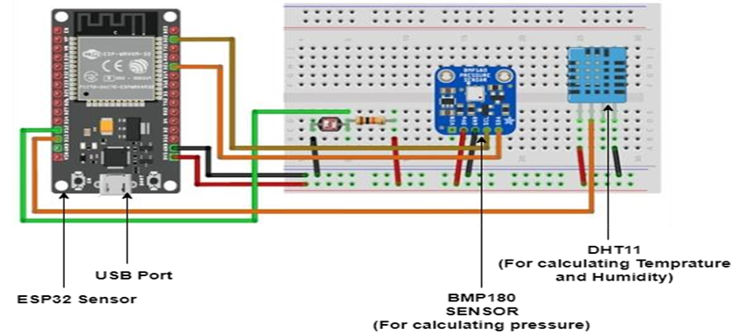
Circuit Diagram For Weather Station Monitoring System using ESP32

Slide 8
Advantages
Simple ,compact easy to handle
Sensor have long life And less cost
Quality of air can be checked indoor as well as outdoor.
Sensors are easily available.

Slide 9
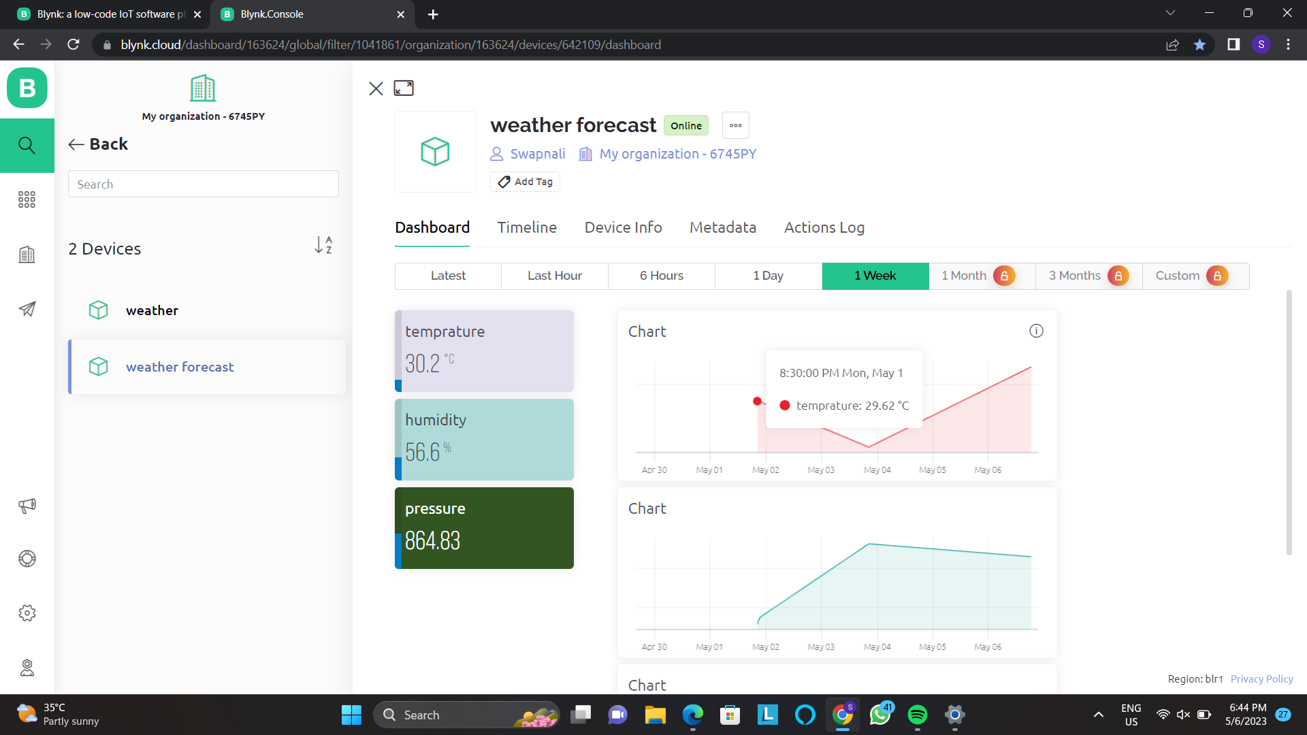
RESULT We observed 3 different environment conditions which included temperature , humidity , pressure.

Slide 10
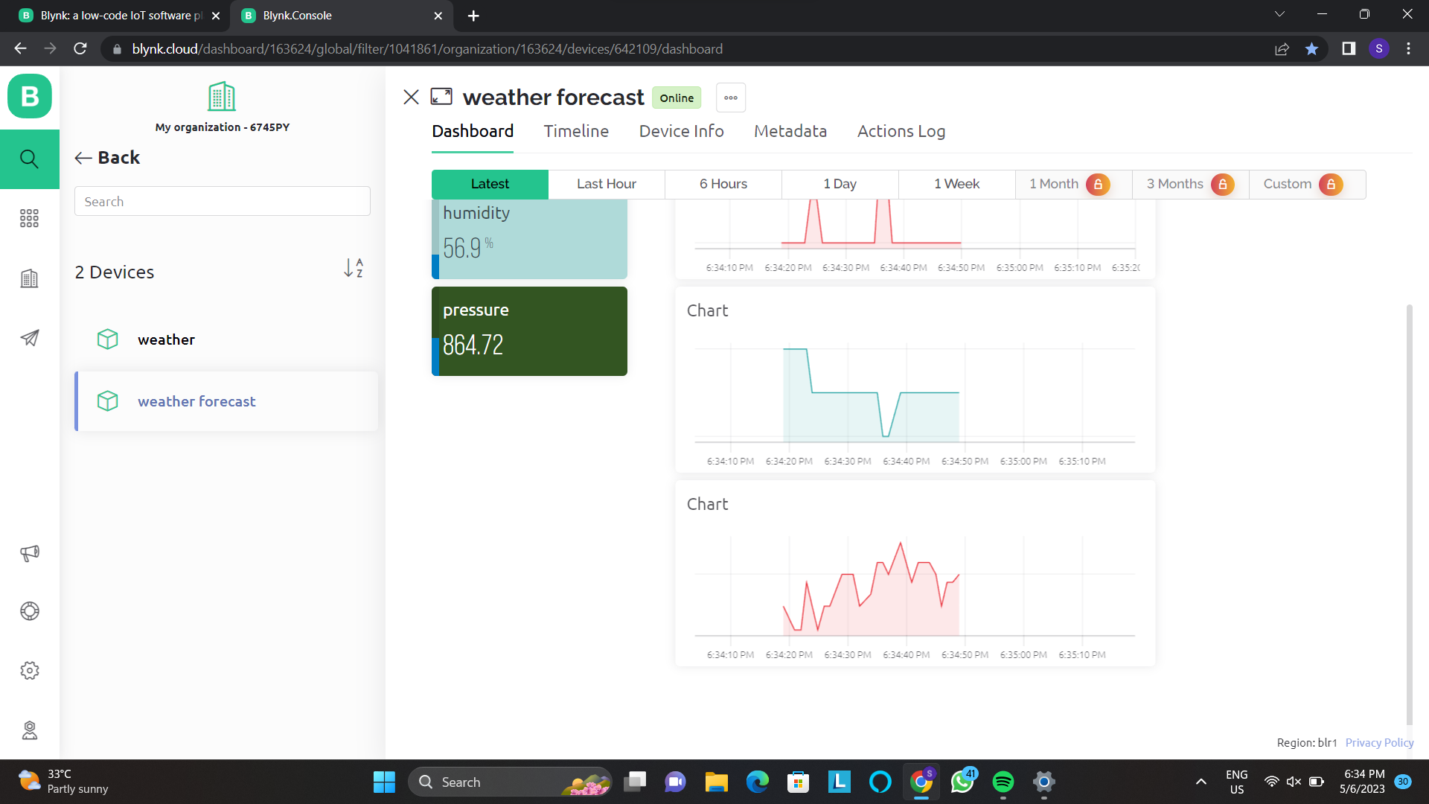

Slide 11
Daily Observation table

Slide 12
Conclusion
We observed the weather conditions (that includes temperature, humidity, pressure and altitude) with our “Web-server based weather monitoring system using ESP32”.
The observed real time data is stored on the Thing Speak server which can be accessed globally. The different values of each environmental factor at different intervals in time are also observed and the observed result clearly shows the changes in the weather conditions for a full day cycle. Hence, we have successfully implemented and tested the web server based weather monitoring system with ESP32 and Thing Speak web server.

Slide 13
References
1) https://www.google.com/amp/s/www.theengineeringprojects.com/2022/04/webserver-based-weather-monitoring-system-using esp32.html/%3famp=1 2) Maier, A., Sharp, A. and Vagapov, Y., November “Comparative analysis and practical implementation of the ESP32 microcontroller module for the internet of things” 2017 . 3) Prisma Megantoro, Brahmantya Aji Pramudita, Vigneshwaran Pandi, “Real-time monitoring system for weather and air pollutant
measurement with HTML-based UI application” June 2021.

Slide 14
THANK YOU……

